Slide 1
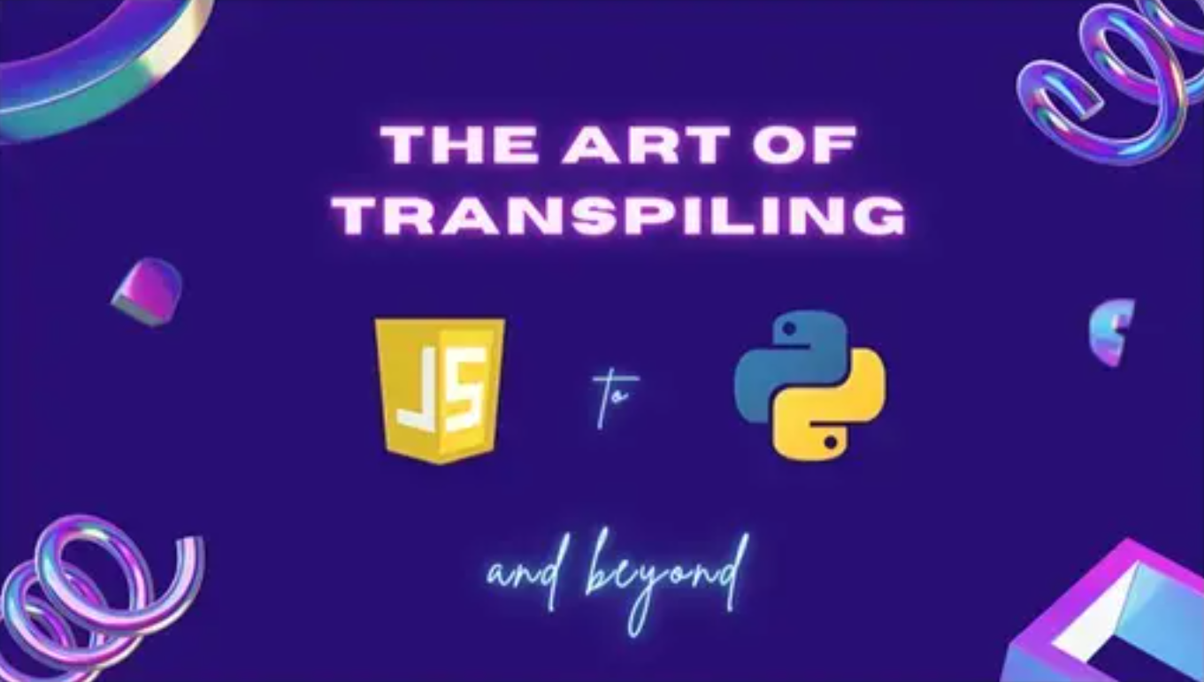

Slide 2


Slide 3





Slide 5
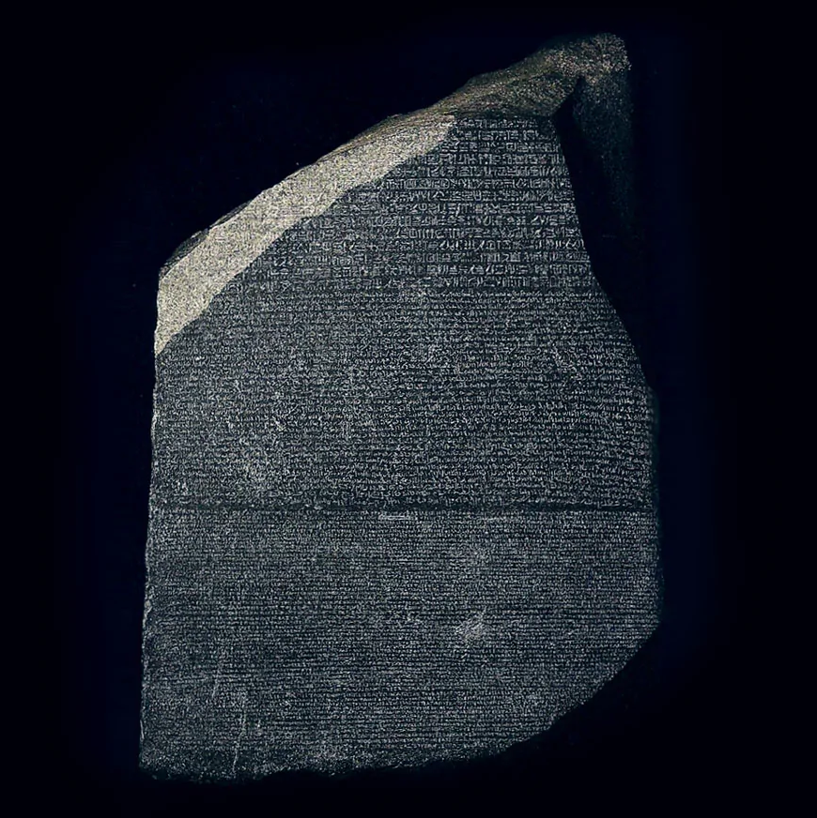

Slide 6

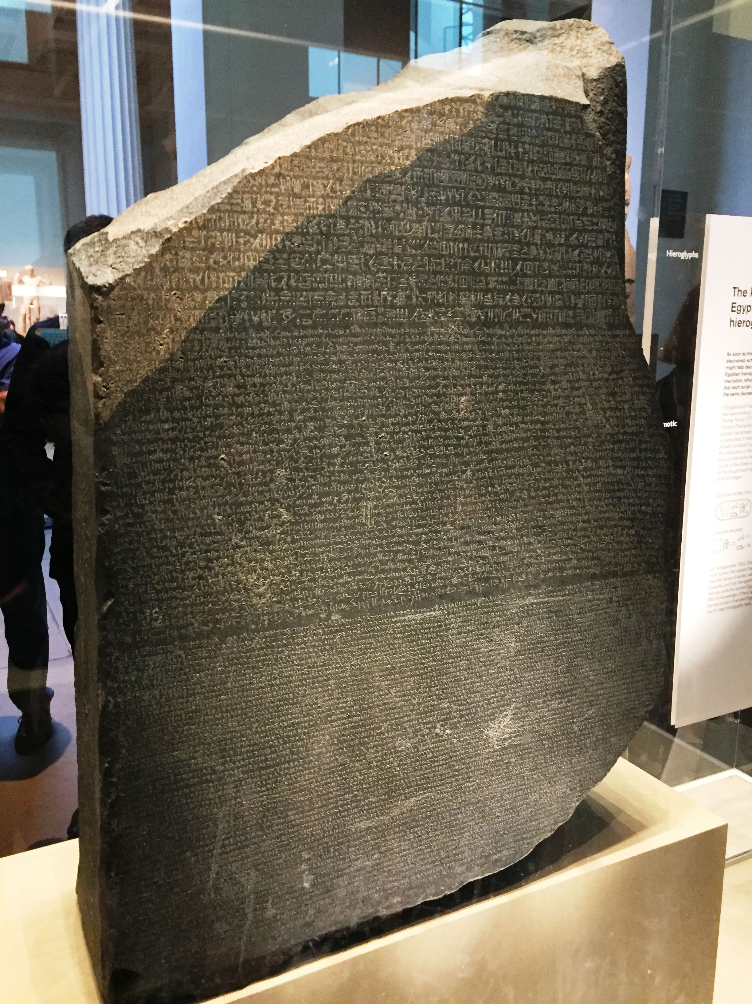

Slide 10
What Is Transpiling ?

Slide 11
What Is Transpiling ?

Slide 12
What Is Transpiling ?
Compiling

Slide 13
What Is Transpiling ?
Compiling
Transcoding

Slide 14
What Is Transpiling ?
Compiling
Translating
Transcoding

Slide 15
What Is Transpiling ?
Compiling
Translating
Transcoding

Slide 16
Transpiling:
Translating source code between programming languages that operate at approximately the same level of abstraction.

Slide 17
Why Do We Do it ?

Slide 18
Why Do We Do it ?

Slide 19
Reasons for Transpiling
Compatibility
Extendibility
Reusability
Reliability

Slide 20
Reasons for Transpiling
Compatibility
Extendibility
Reusability
Reliability

Slide 21
Reasons for Transpiling
Compatibility
Extendibility
Reusability
Reliability

Slide 22
Reasons for Transpiling
Compatibility
Extendibility
Reusability
Reliability

Slide 23
Reasons for Transpiling
Compatibility
Extendibility
Reusability
Reliability

Slide 24
Reasons for Transpiling
Compatibility
Extendibility
Reusability
Reliability

Slide 25
Is all transpiling the same?

Slide 26
Is all transpiling the same?

Slide 27
Transpiling Priorities
Machine Interpretability
Human Interpretability

Slide 28
Transpiling Priorities
Machine Interpretability
Human Interpretability

Slide 29
Transpiling Priorities
Machine Interpretability
Human Interpretability

Slide 30
Transpiling Priorities
Machine Interpretability
Human Interpretability

Slide 31
How Do We Do it?

Slide 32
i = expression

Slide 33
i = expression
i = 1 + 2

Slide 34
i = expression
i = 1 + 2
i = "string1" + "string2"

Slide 35
i = expression
i = 1 + 2
i = "string1" + "string2"
i = "string1" + 2

Slide 36
Breaking
Breaking down a language into abstract categories

Slide 37
Breaking down a language into abstract categories

Slide 38
Common abstract categories:

Slide 39
Common abstract categories:
Syntax
Operators
Keywords
Features
Libraries

Slide 40
Syntax

Slide 41
Syntax

Slide 42
Syntax :
“set of rules that define the combinations of symbols that are considered to be correctly structured statements or expressions…”
Source: Wikipedia.org

Slide 43
Syntax :
“set of rules that define the combinations of symbols that are considered to be correctly structured statements or expressions…”
Source: Wikipedia.org

Slide 44
Syntax :
Stuff that uses these things:
", ( ), { }, [ ], ;, : , \n, \t
Source: Wikipedia.org

Slide 45
Syntax :
Stuff that uses these things:
", ( ), { }, [ ], ;, : , \n, \t
Source: Wikipedia.org

Slide 46
Syntax :
Create blocks of code (conditions, loops, classes, functions)
define statements
declare variables
instantiate objects
separate values and conditions

Slide 47
Operators :
Symbol that represents an action or process

Slide 48
Operators :
Symbol that represents an action or process

Slide 49
Operators :
Assignment (=, +=…)
Arithmetic (+, -, /, *, %...)
Boolean (&&, ||, !)
Relational (<, > , ==…)
Bitwise (&, |, ^, ~)

Slide 50
Operators :
Assignment (=, +=…)
Arithmetic (+, -, /, *, %...)
Boolean (&&, ||, !)
Relational (<, > , ==…)
Bitwise (&, |, ^, ~)

Slide 51
Keywords :
Words reserved by a language for a specific purpose

Slide 52
Keywords :
Words reserved by a language for a specific purpose

Slide 53
Keywords :
Javascript
Python
abstract arguments await boolean
break byte case catch
char class const continue
debugger default delete do
double else enum eval
export extends false final
finally float for function
goto if implements import
in instanceof int interface
let long native new
null package private protected
public return short static
super switch synchronized this
throw throws transient true
try typeof var void
volatile while with yield
False None True and
as assert async await
break class continue def
del elif else except
finally for from global
if import in is
lambda nonlocal not or
pass raise return try
while with yield

Slide 54
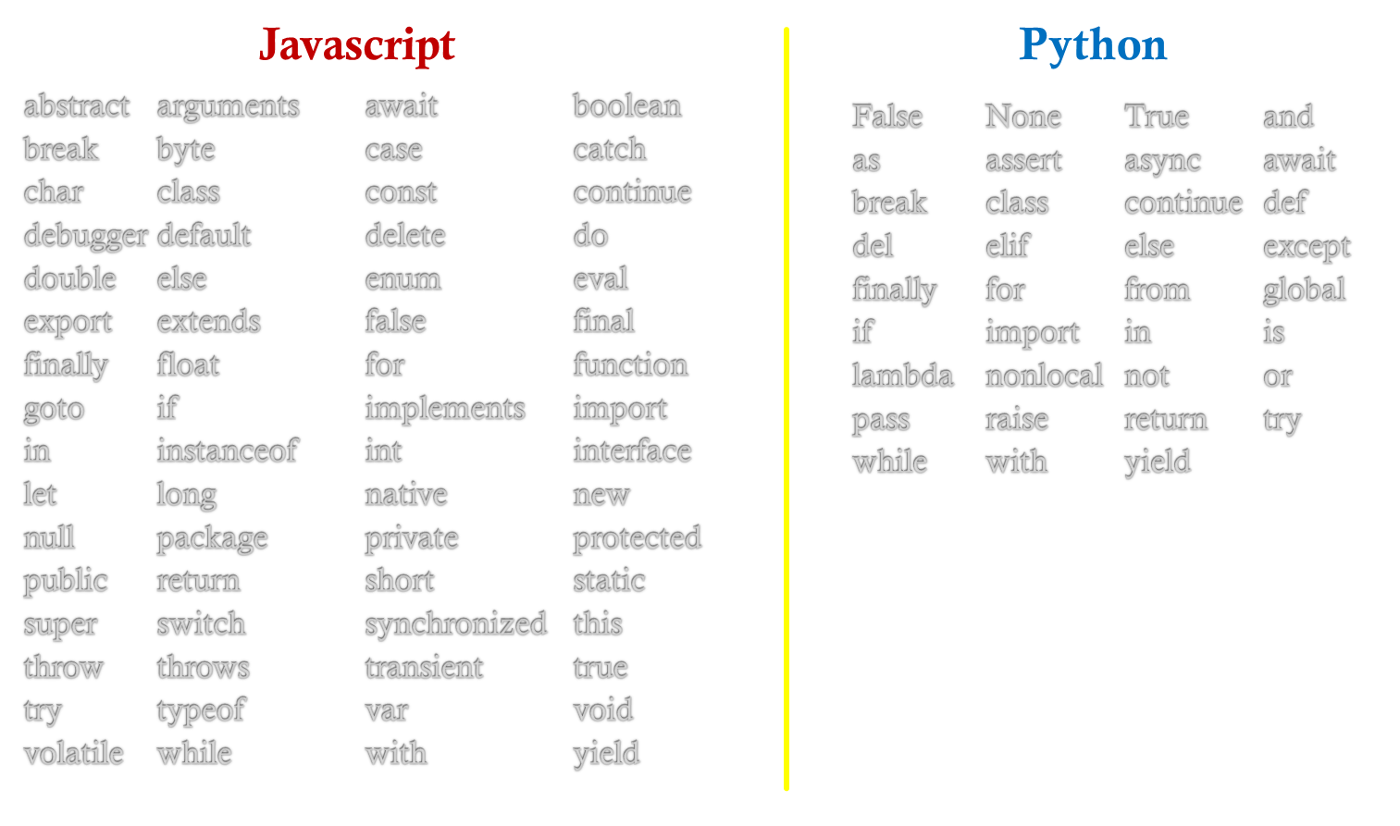
Keywords :

Slide 55
Features :
A “distinguishing characteristic of a software item (e.g., performance, portability, or functionality).”
Source: IEEE 829

Slide 56
Features :
A “distinguishing characteristic of a software item (e.g., performance, portability, or functionality).”
Source: IEEE 829

Slide 57
Features :
Data types (Strings, numbers, Objects, Date)
Loops (for, do, while, iterators)
Conditional statements
Boolean expressions
Collections (Array, Map, Set…)
Built-in functions
Import statements

Slide 58
Features :
Data types (Strings, numbers, Objects, Date)
Loops (for, do, while, iterators)
Conditional statements
Boolean expressions
Collections (Array, Map, Set…)
Built-in functions
Import statements

Slide 59
Libraries :
A “suite of data and programming code that is used to develop software programs and applications.”
Source: Techopedia.com

Slide 60
Libraries :
A “suite of data and programming code that is used to develop software programs and applications.”
Source: IEEE 829

Slide 61
Libraries :
Language (Strings, numbers, exceptions…)
Utilities (collections, formatting, datetime…)
I.O. (files, text, bytes, buffers…)
Cryptography (sha-256, hmac, public/private keys…)
Networking (URL, IPAddress, Socket's…)

Slide 62
Libraries :
Language (Strings, numbers, exceptions…)
Utilities (collections, formatting, datetime…)
I.O. (files, text, bytes, buffers…)
Cryptography (sha-256, hmac, public/private keys…)
Networking (URL, IPAddress, Socket's…)

Slide 63
Common abstract categories:
Syntax
Operators
Keywords
Features
Libraries

Slide 65
https://github.com/JonBoynton/JSConvert

